Slide 1


Code Optimization on the Midway2 HPC cluster
Khemraj Shukla
RCC
University of Chicago
December 8, 2020

Slide 2
Goals
To be familiar with aspects of computer hardware that affect the performance of numerical codes, such as caches, registers, vector processors, and the memory hierarchy.
To know compiler optimization flags, and how and when to use them. Hardware concepts come into play here too, because libraries and compilers can be used more intelligently when one has a basic understanding of what they aim to do.

Slide 3
Overview
During the advent of of FORTRAN in 1950’s,
Criticism: Machine code generated by a Fortran compiler could never be as optimized as hand-coded assembly language.
Solution: Claim was debunked by the arrival of compiler and gradually they becoming smarter.
Question: So why should anyone bother learning about code optimization (unless one is creating the code-generators in the compilers themselves)?
Answer: compiler still "needs help" in transforming your program into an optimized executable. In such instances, it is good to understand what the compiler is trying to do on your behalf. Moreover, you are more likely to use high-performance software libraries in a better way if you know a little about what they do behind the scenes.

Slide 4
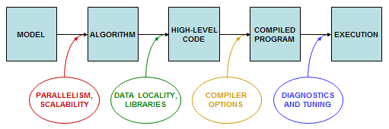
Code Optimization
Apply basic aspects of code optimization that can have a big impact, such as using libraries, or exercising knowledge of compiler flags, along with a few code-writing habits that avoid the worst kinds of performance pitfalls.
To do rough tuning, it helps to know about common microarchitectural features like SSE and AVX (to be defined later), and it helps to have a sense of how the compiler tries to optimize instructions to use those features, when given a particular chunk of code.

Slide 5
Single core optimization
Factors which affect the performance of code
Creating a layout of data structures that results in efficient memory accesses
Employing optimized HPC libraries where possible in your program
Using appropriate compiler options when building your application

Slide 6
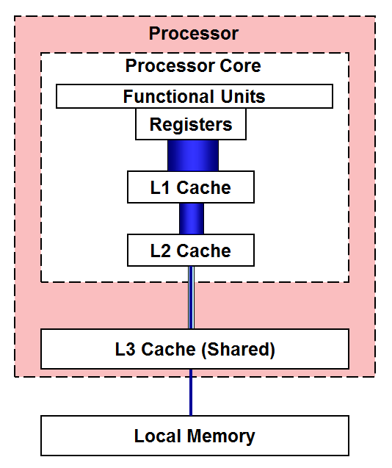
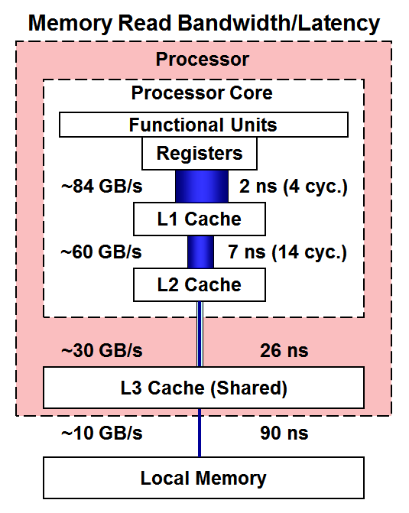
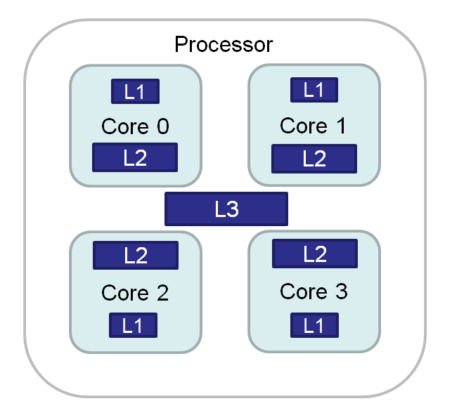
Single core optimization: Latency and Bandwidth
Cores and Caches in a Generic 4-Core Processor
Memory Levels in an Intel Xeon "Skylake" Processor

Slide 7
Intel SSE & Intel AVX-128 Data Types

Slide 8
Intel Advanced Vector Extensions 2 (Intel AVX2) Data Types

Slide 9
Intel Advanced Vector Extensions 512(Intel AVX-512) Data Types

Slide 10
Vectorizable Math Functions

Slide 11
Factors impacting the vectorization

Slide 12
Vectorization and loop unrolling

Slide 13
Demo
ex0

Slide 14
Will it vectorize effectively?

Slide 15
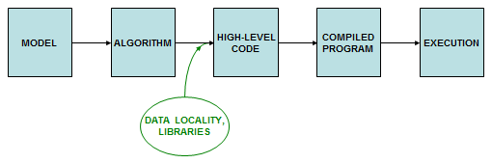
Data locality
Principles of good data locality
Code accesses contiguous, stride-one memory addresses
data are always fetched in cache lines which include neighbors
inner loops are instantly vectorizable via SSE, AVX, or AVX-512
Code emphasizes cache reuse
when multiple operations on a data item are grouped together, the item remains in cache, where access is much faster than RAM
Data are aligned on important boundaries (e.g., doublewords)
items don't straddle boundaries, so efficient one-shot access is possible
it is a precondition for fetching data as a single vector, single cache line, etc.

Slide 16
Data Locality

Slide 17
Demo
ex1

Slide 18
Data Locality: 2D data structure

Slide 19
Loop In-variant

Slide 20
Compiler flags
-O0 for fast compilation without optimization.
-O1 for limited optimization that does not increase code size
-O2 for moderate optimization including vectorization (with the Intel compilers). Debugging support is retained if -g is also specified.
-O3 for aggressive optimization, resulting in longer compile time, more trading of space for speed, and possibly marginal effectiveness. This may change code semantics and, occasionally, results. It also enables the optimizations present in -O2.

Slide 21
Compiler flags
Compilers | Flags for Skylake
Intel icc or ifort | -O3 -xCORE-AVX512
GNU gcc or gfortran | -O3 -march=skylake-avx512

Slide 22
Demo
ex2

Slide 23
Python debugger
>>> ipython

Slide 24
Python profiler
shell> python -m cProfile prof_prog.py

Slide 25
Demo
ex3

Slide 26
Intel debugger: idb
module load intel/16.0
source /software/intel/parallel_studio_xe_2016_update3/bin/compilervars.sh intel64
gdb-ia
file helloworld_c
run
Next # to execute next line

Slide 27
Demo
ex4

Slide 28
Vtune:
module load intel/19.1.1
cd /software/intel/parallel_studio_xe_2020_update1/vtune_profiler_2020/bin64/vtune-gui

Slide 29
Summary
Optimization can improve the performance substantially
Knowing the underlying hardware architecture will let you map your code efficiently.
Existing debugger, profiler and library could be very useful for achieveing the performance.

Slide 30
Thank You!

